Slide 1
PORTOFOLIO DATA ANALYST
SALES STRATEGY INACCURACIES IN SUPERSTORES
Nahdiyah Purnama

Slide 2








About Me
Education
D3 Teknik Elektro Politeknik Negeri Jakarta
Experience
Jasa Marga - Internship
Kalbe Nutritionals X Rakamin - Virtual Internship (Project Based)
Contact
082118134474
Cilegon, Banten
E-Mail : nahdiyahpurnama@gmail.com
Nahdiyah Purnama

Slide 3
PROJECT BACKGROUND
Superstore developed an application system to collect transaction data at each branch, the data is expected to be utilized to enhance the company's sales performance.The inaccuracy of the sales strategy at each Superstore branch, which is to give a sizable discount program when the sales level is extremely high, is the issue that is frequently brought up as a complaint.This can be detrimental to the store because large discounts can reduce profitability. To be able to overcome these problems, an analysis is carried out which has the goals of increasing sales and profits, maximizing efficient resource allocation at each Superstore branch; and identifying mistakes or unsuccessful sales strategy decisions in order to make changes and prevent such difficulties in the future.

Slide 4



Tools
Google Colab
Looker Studio
Python

Slide 5
Data Set
Field Name | Description
Order_ID | Unique Order ID for each Customer
Customer_ID | Unique ID to identify each Customer
Postal_Code | Postal Code of every Customer
Product_ID | Unique ID of the Product
Sales | Sales of the Product
Quantity | Quantity of the Product
Discount | Discount provided
Profit | Profit/Loss incurred
Category | Category of the product ordered
Sub-Category | Sub-Category of the product ordered
Field Name | Description
Product_Name | Name of the Product
Order_Date | Order Date of the product
Ship_Date | Shipping Date of the Product
Ship_Mode | Shipping Mode specified by the Customer
Customer_Name | Name of the Customer
Segment | The segment where the Customer belongs
City | City of residence of of the Customer
State | City of residence of of the Customer
Region/Country | Region where the Customer belong/ Country of residence of the Customer

Slide 6
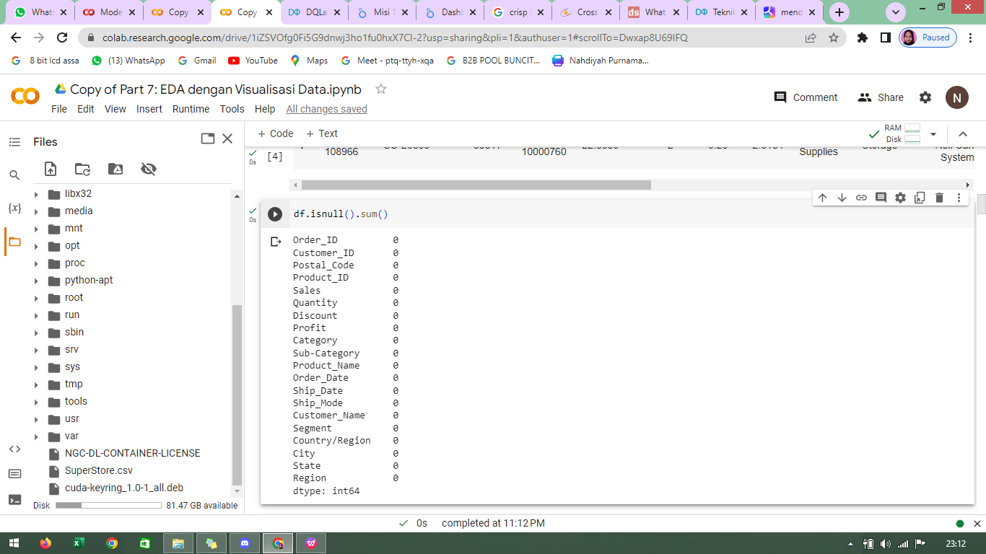
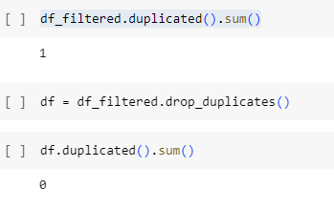
Data Cleaning
Data null Data Duplicate

Slide 7
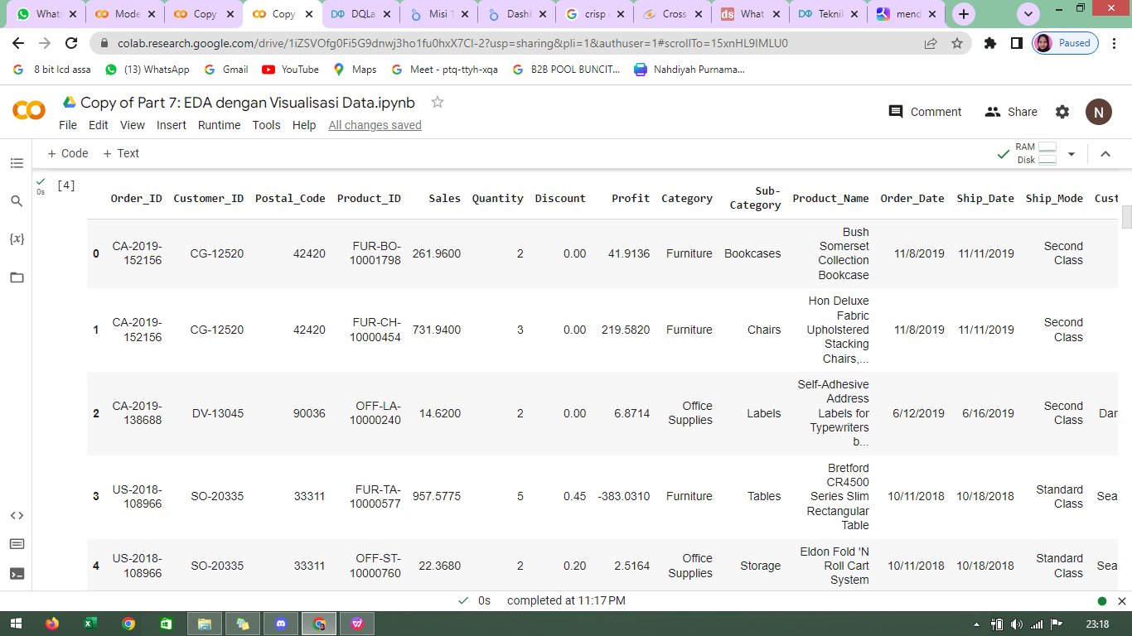
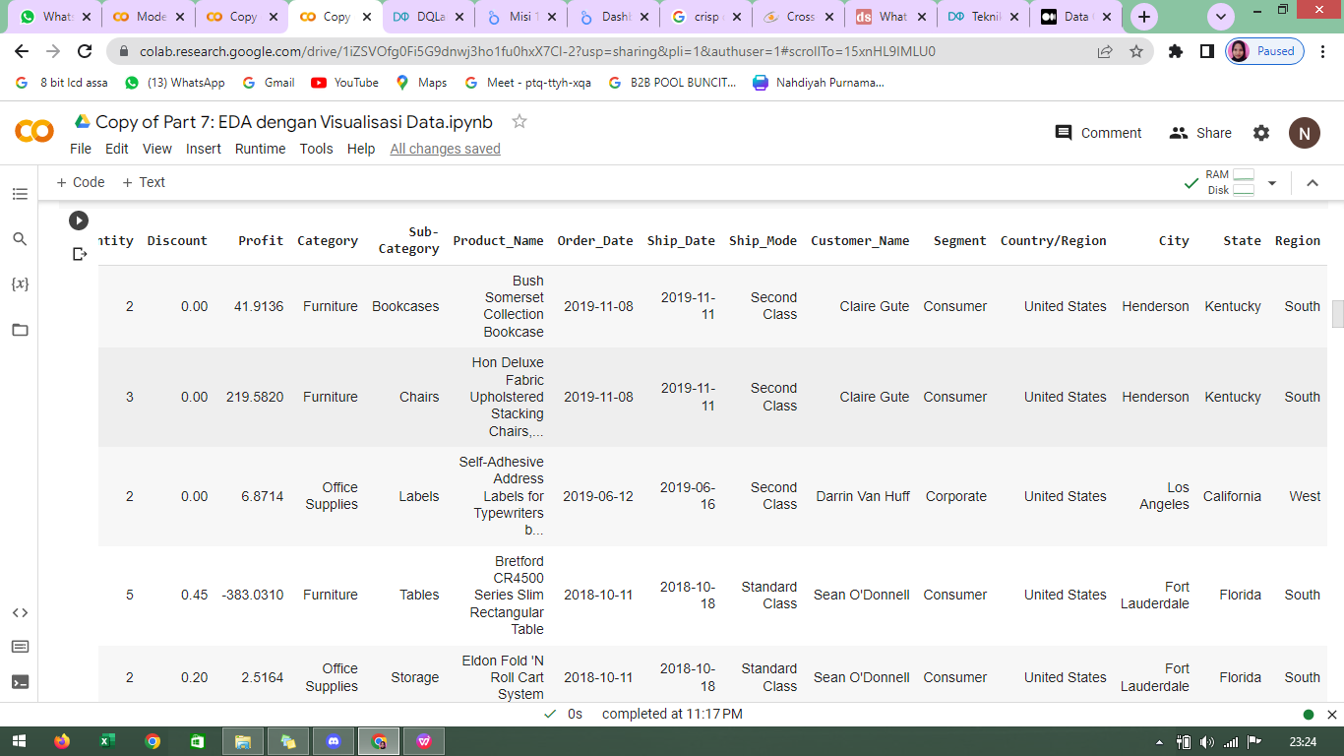
Converting Format Time
Before
After

Slide 8
E D A (EXPLORATORY DATA ANALYSIS)
Total Sales and Total Profit based on Segment
Total Sales and Total Profit based on Segment

Slide 9
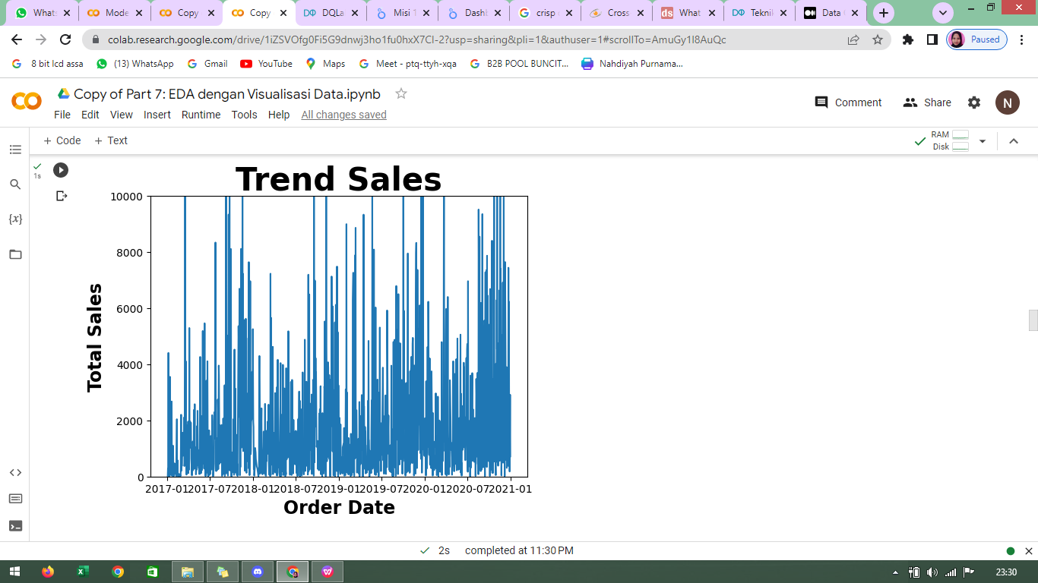
Trend Sales
From January 2017 through January 20221, total sales likely to vary. Due to the huge year-end discount, sales increased significantly at the end of each year. The largest sales happened in November 2020, with 118,447 units sold. The majority of sales are less than 5000 units. There are signs of outliers in the period around 2017-02.

Slide 10
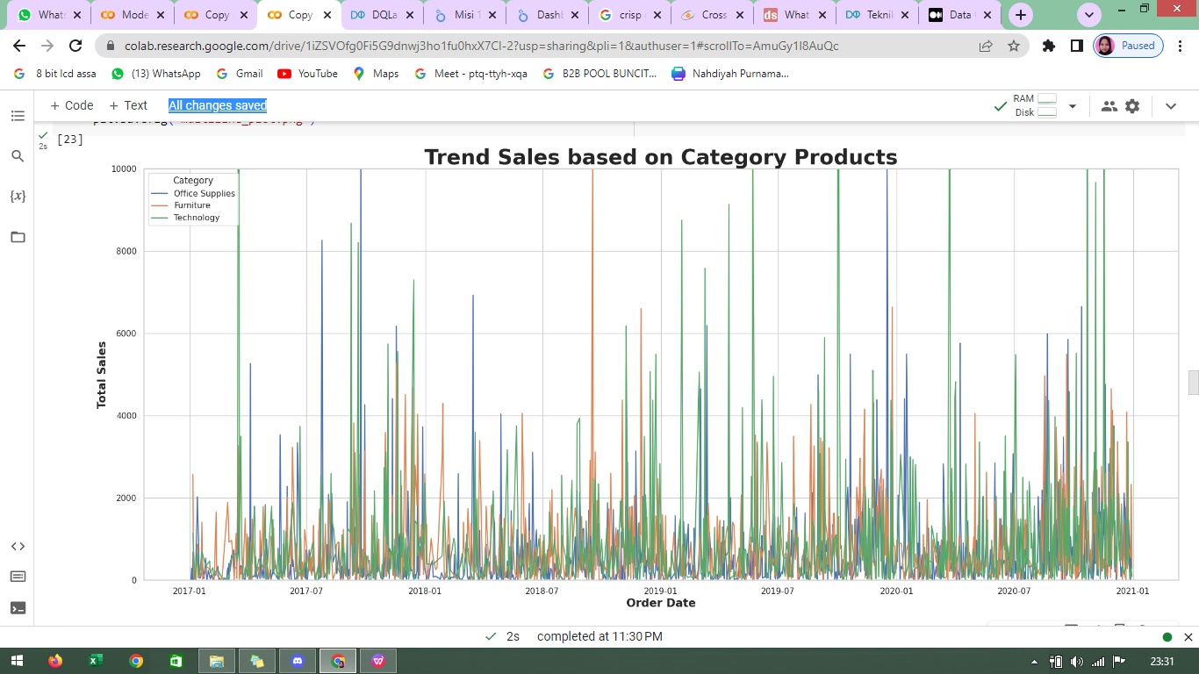
Trend Sales based on Category Products
Technology sector dominate sales every year. Furniture is the lowest sales product. There are indications of outliers in some periods due to technology products.

Slide 11
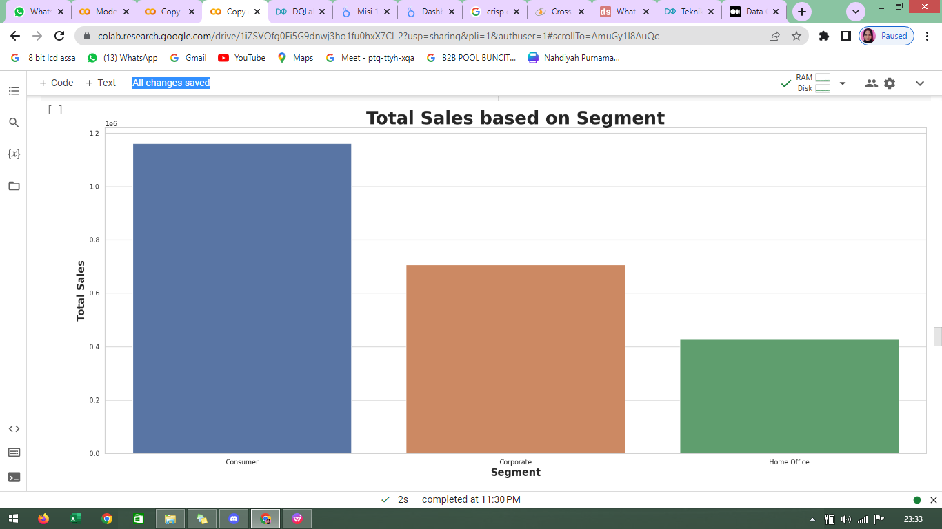
Total Sales based on Segment
The total sales of the Consumer segment are the most dominating,t, which is around 50% of all total sales, while total sales of Home Office are the lowest at around 18.7% and total sales of the Corporate segment are around 30.7% .

Slide 12
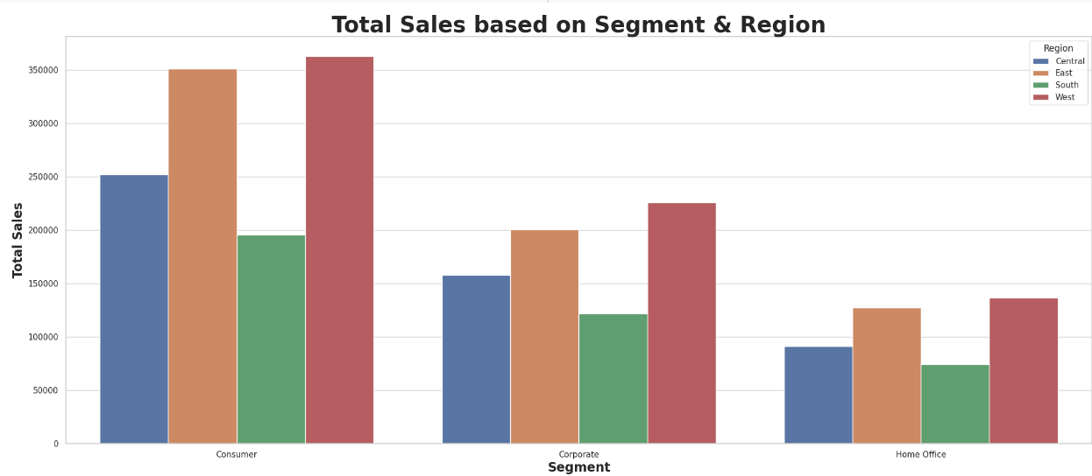
Total Sales based on Segment and Region
Sales patterns based on segments in various regions are relatively the same. Sales are dominated in the west and east regions.

Slide 13
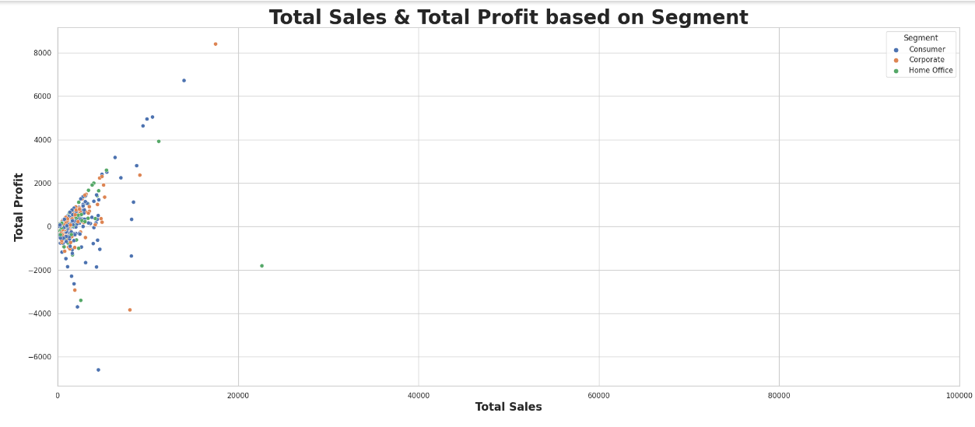
Total Sales and Total Profit based on Segment
All total sales and total profit patterns are almost the same. The highest total sales and total profit came from the corporate segment while the lowest total sales and total profit are from the consumer segment, which suffered a considerable loss.

Slide 14
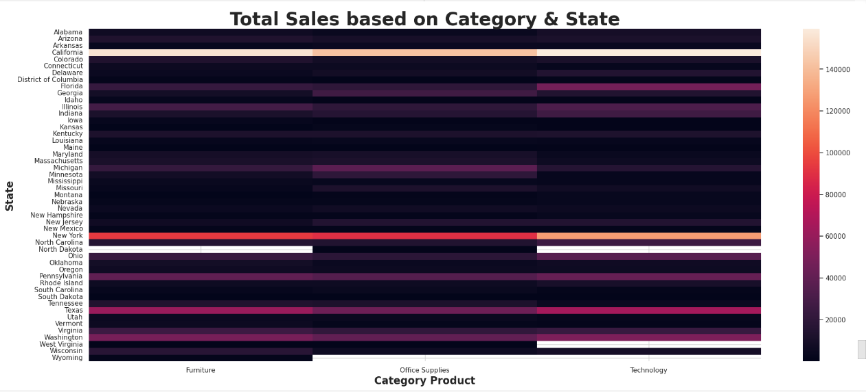
Total Sales based on Category and State
The highest sales were in California & North Dakota with more than 140,000 sales.
In the North Dakota region, office supplies were the smallest of the other two products. Average sales at each superstore branch ranged under 4000.

Slide 15
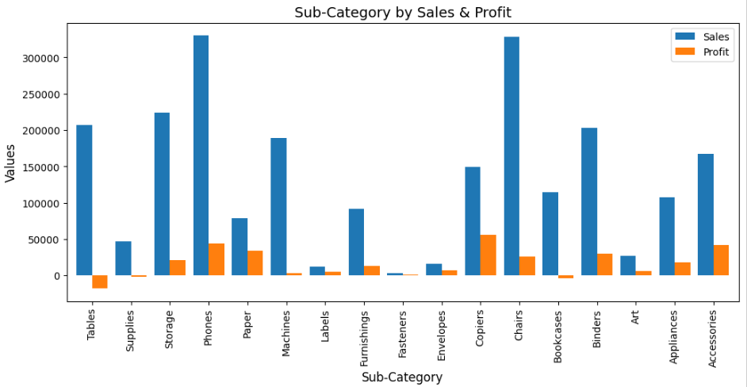
Sub-Category by Sales and Profit
Sales of subcategory items that table ranks fourth in sales but incurred the most losses, in addition to tables, book cases and supplies are also subcategory products that suffer sales losses. Copiers are the most profitable subcategory product. Phones are high-profit and high-sales products.

Slide 16
HOW TO IMPROVE ?
If the sub-categories products of supplies, bookcases, and tables are removed, the profit margin will increase to 16%.

Slide 17
DATA MODELLING

Slide 18
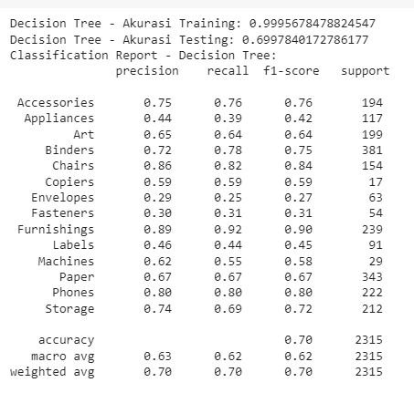
Data Modelling menggunakan Decision Tree Classifier
Sub-Category target modeling using the Decision Tree Classifier obtained a training accuracy value of 99% and testing accuracy of 69%.

Slide 19
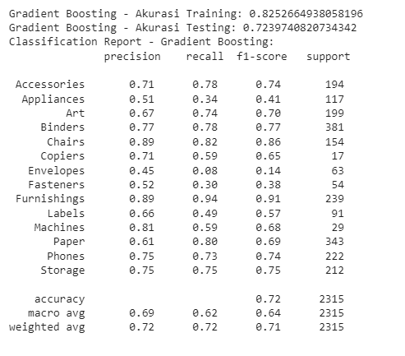
Data Modelling menggunakan Gradient Boosting
Sub-category target modelling using Gradient Boosting gets a training accuracy of 82% and and a testing accuracy of 72%.

Slide 20
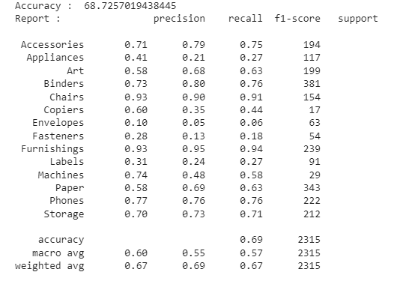
Data Modelling menggunakan Random Forest Classifier
Sub-category target modelling using Random Forest Classifier gets a training accuracy 68%.

Slide 21
DASHBOARD SUPERSTORE

Slide 22
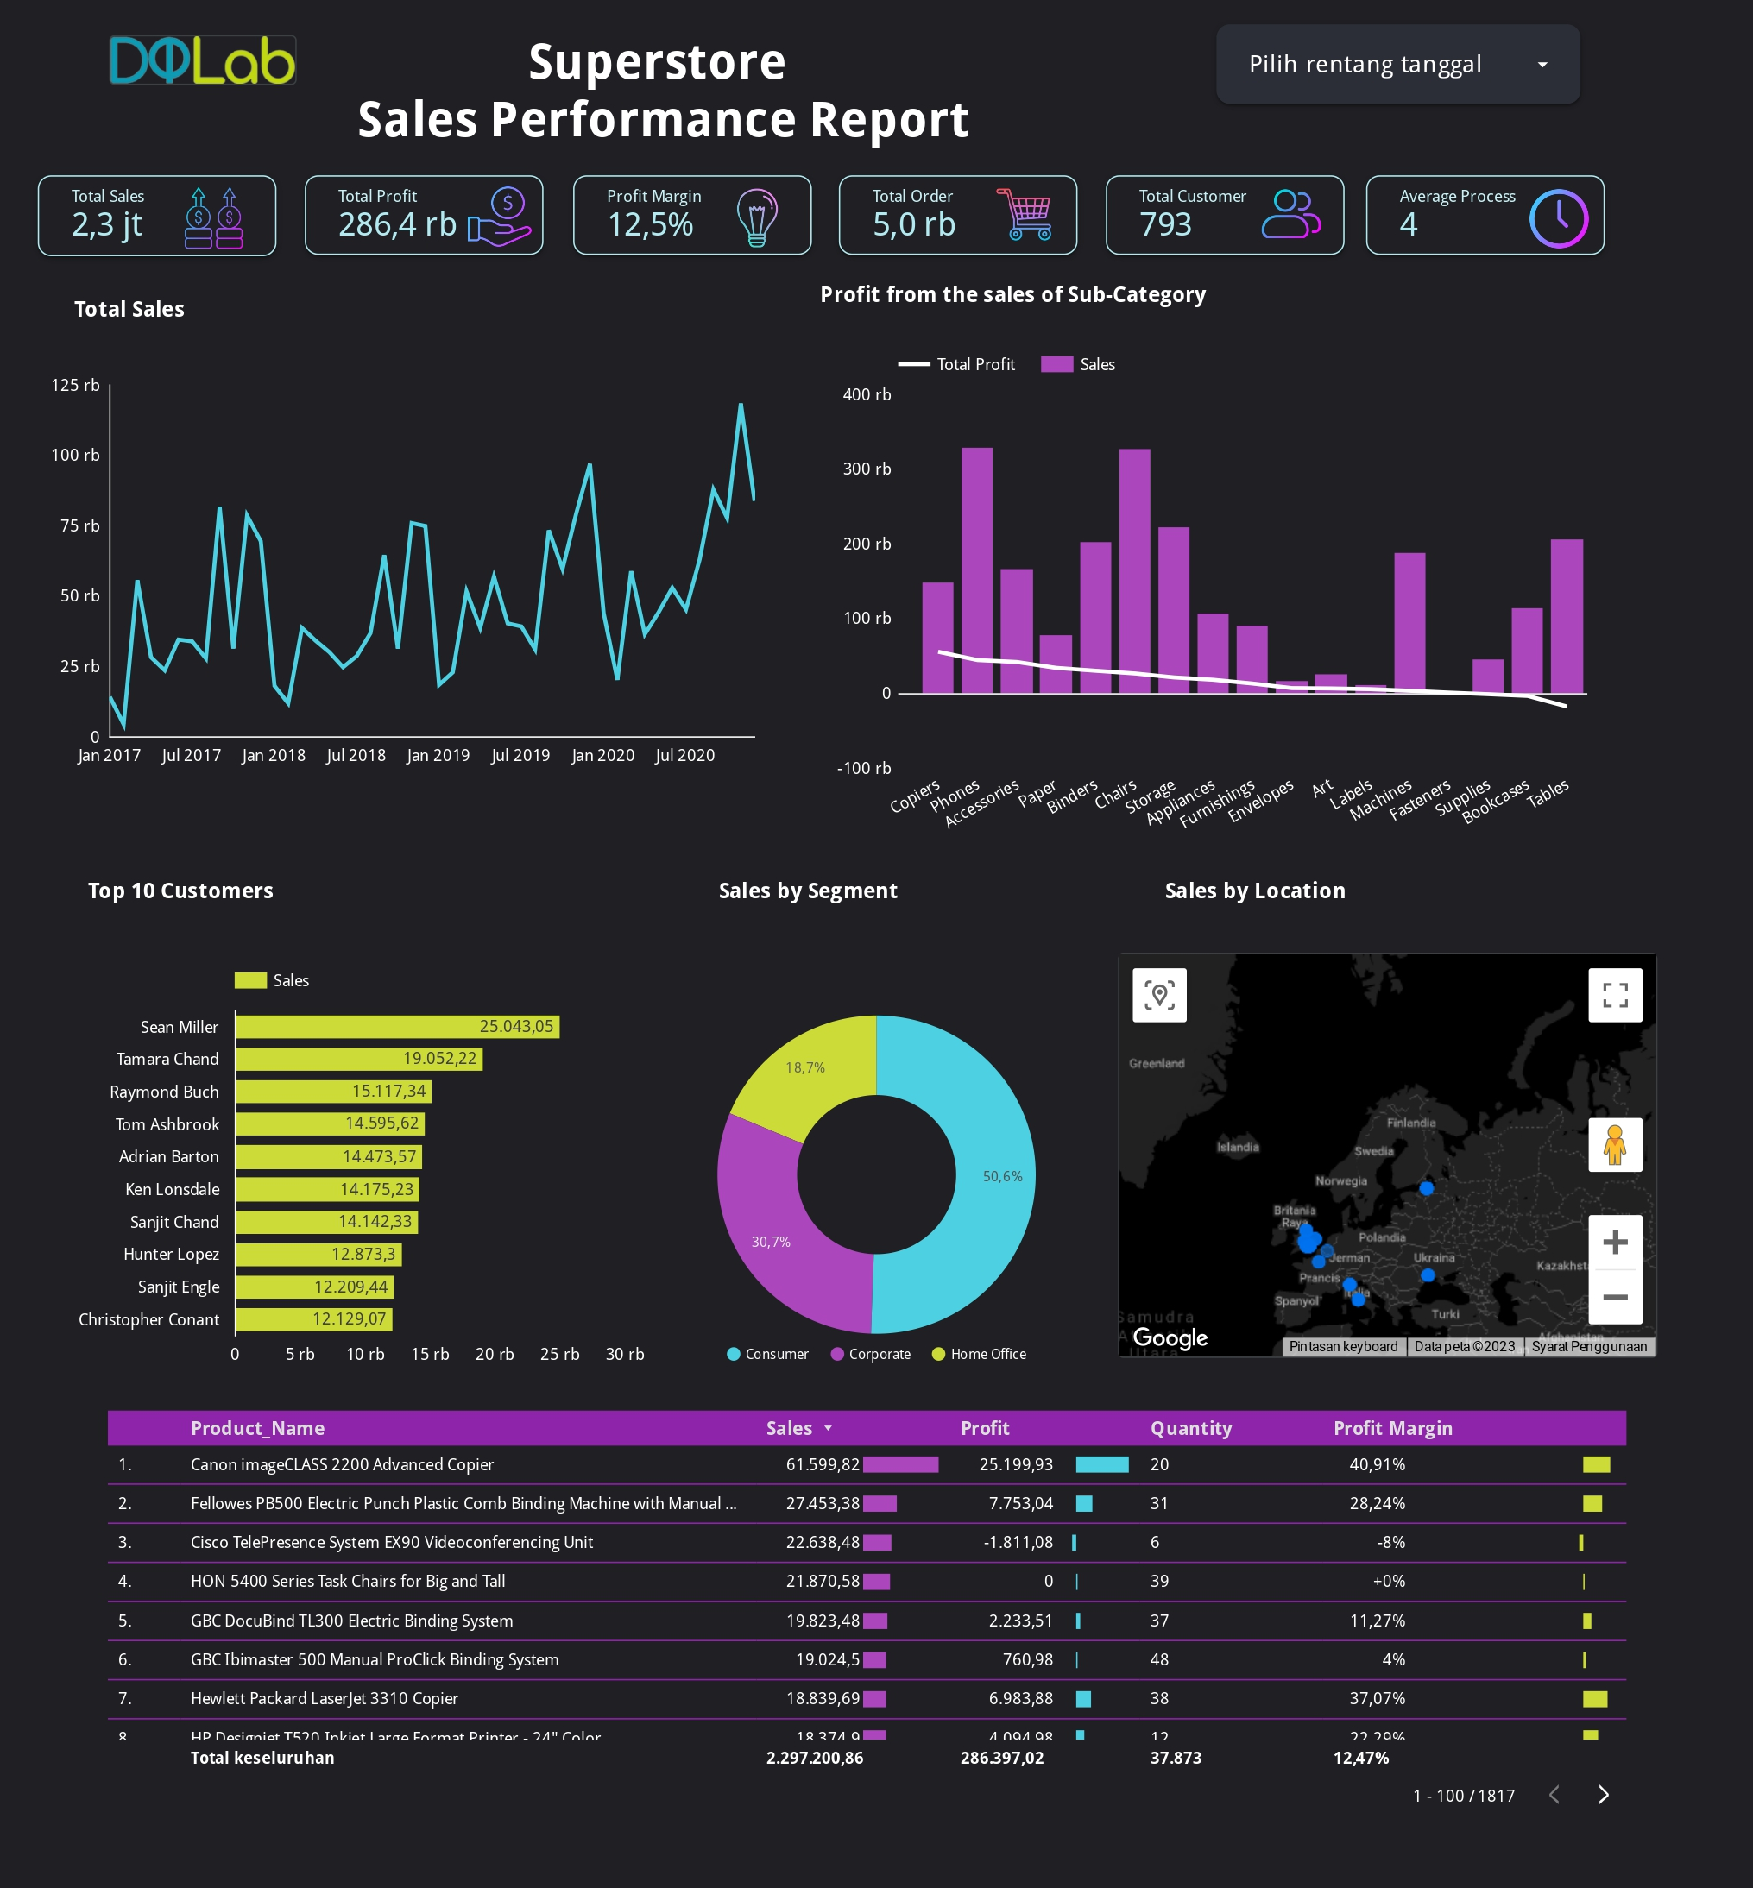
DASHBOARD
Link :
https://lookerstudio.google.com/reporting/e74a1f49-b328-49d5-8bd8-d67ba1d30cc5

Slide 23
KESIMPULAN
According to the findings of the EDA (Expaloratory Data Analysis), the Consumer category dominates the most, accounting for around 50% of total sales. Due to the huge year-end discount, sales increased significantly at the end of each year. Copiers are the most profitable subcategory product sales. Sales of sub-category products that suffered the losses come from tables, book cases, and supplies.
To overcome the loss of inaccurate sales strategies at each superstore branch, the sub-category products of supplies, bookcases, and tables are eliminated, the profit margin will increase to 16%. from 3 machine learning modelling data it can be concluded that modelling using Decision Tree Classifier is higher in accuracy than using Gradient Boosting and Random Forest Classifier, hence Decision Tree Classifier is utilized.

Slide 24
Link Google Colab EDA (EXPLORATORY DATA ANALYSIS) :
https://colab.research.google.com/drive/1VZXVhbCbrwx-ojybK7R17sGcmLLR8YaM?usp=sharing
Link Google Colab Data Modelling Machine Learning :
https://colab.research.google.com/drive/1jw3XTFQgaC0ANgbvWhNQqF6aw6y_fW0u?usp=sharing
Link Looker Studio Dashboard :
https://lookerstudio.google.com/reporting/e74a1f49-b328-49d5-8bd8-d67ba1d30cc5

